Slide 1
Welcome to CS4222 PSLG!
With Robert and Jakub

Slide 2

Java ArrayLists
Unlike regular arrays which are data structures, an ArrayList is a class. This means we can use javas inbuilt functions to remove, add or even modify values inside our ArrayList.​
To create an ArrayList, we can use this syntex to create one:​
ArrayList agelist = new Arraylist ();​
agelist.add(2)​
agelist.add(3)​
Access:​
System.out.println(arrayList);​
// Outputs [2,3]

Slide 3
Problem 1
Using ArrayLists fill an array with 10 integers and print out the second, fifth and ninth values.

Slide 4
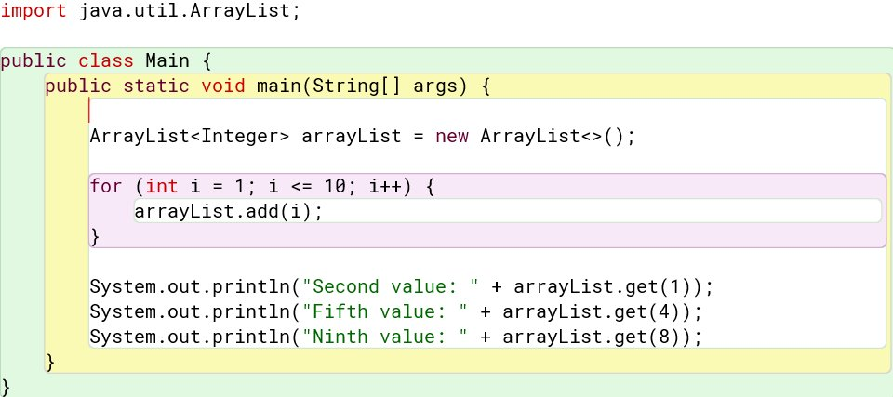
Answer:

Slide 5
Problem 2
Fill an ArrayList with 10 values and add them all together.

Slide 6
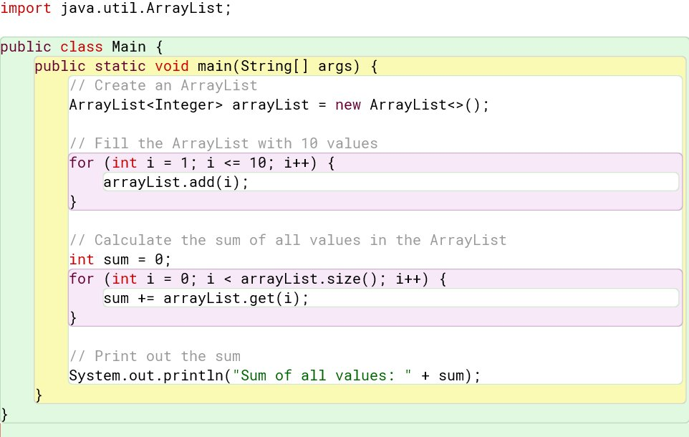
Answer:

Slide 7
Problem 3
Fill an ArrayList from 1 to 10 and remove anything in the array that is smaller than or equal to 5 and print out everything else.

Slide 8
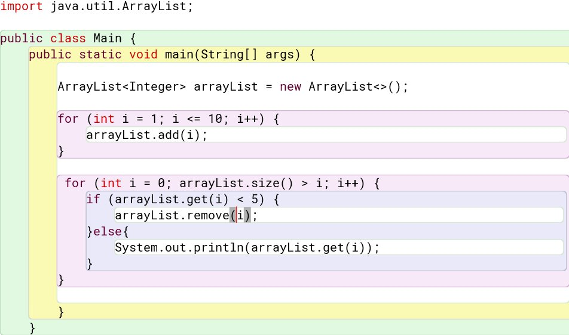
Answer:

Slide 9
Problem 4
Get the average value of all the elements in your ArrayList and any value that is smaller, modify that number to be 0.

Slide 10
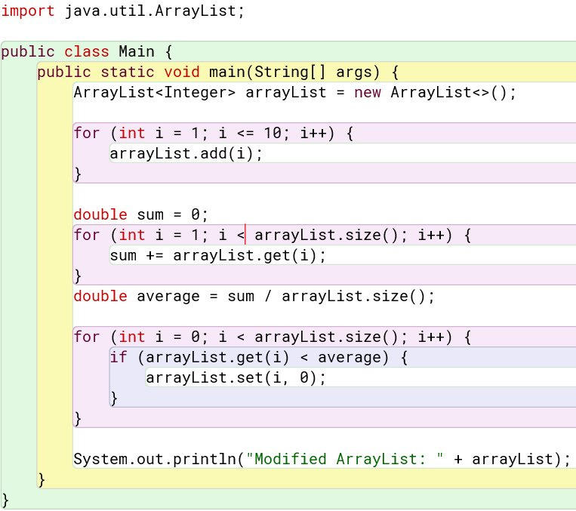
Answer:

Slide 11

Thank you for coming!

